Slide 1

Doub less Living!
The Gospel of
LUKE
That you may have certainty!

Slide 2
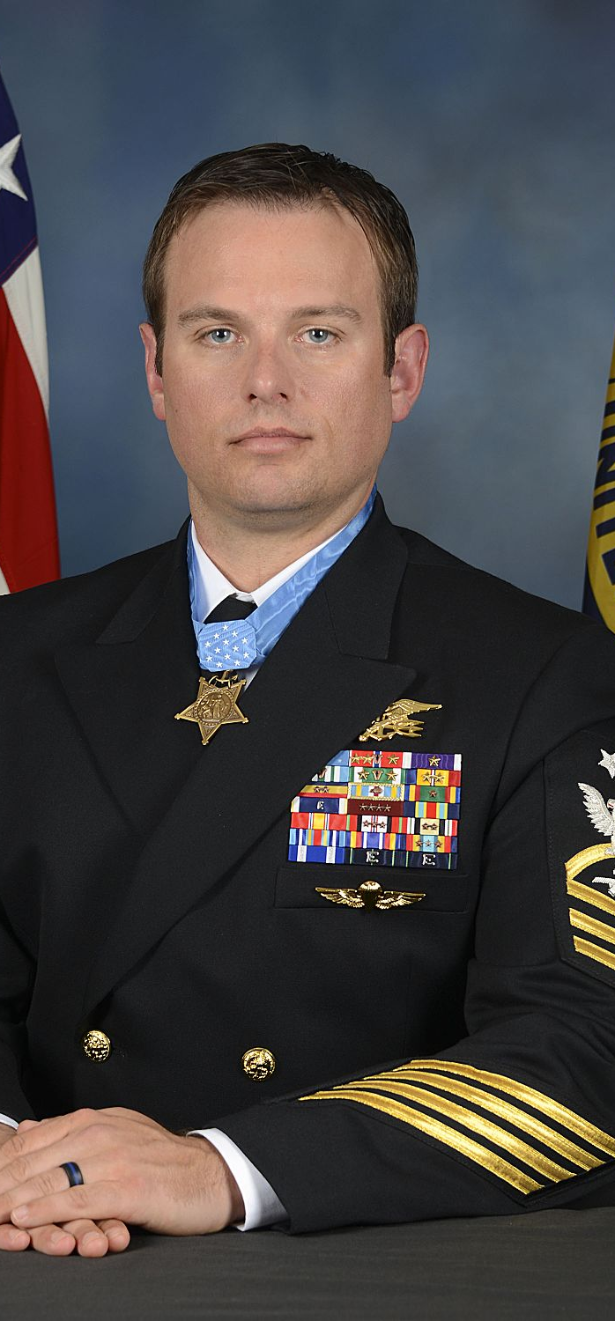
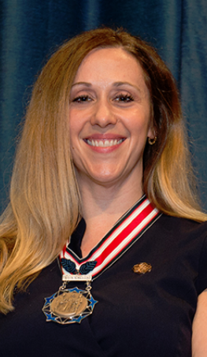

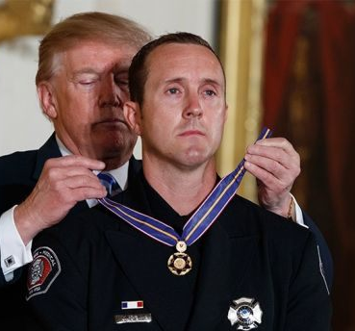
What Do All of These People Have in Common?

Slide 3
Each of them put the needs and well-being of others ahead of their own at great personal risk.
Can you think of anyone who has done that for you personally?
How were they recognized for their valor, courage or bravery?

Slide 4
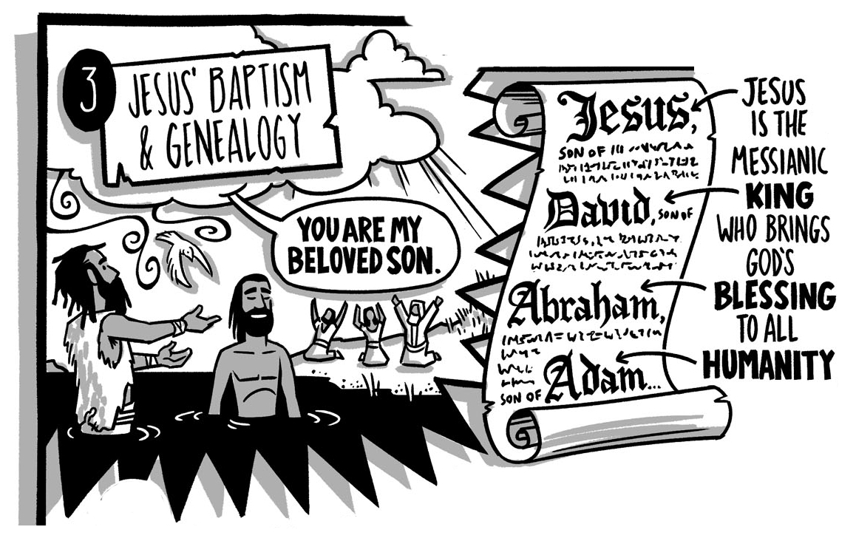
The Baptism of Jesus Luke 3:21-38 Matthew 3:13-17

Slide 5
²¹ When all the people were baptized, Jesus also was baptized. As he was praying, heaven opened, ²² and the Holy Spirit descended on him in a physical appearance like a dove. And a voice came from heaven: "You are my beloved Son; with you I am well-pleased."
The Baptism of Jesus
Luke 3:21-22

Slide 6
²¹ When all the people were baptized, Jesus also was baptized. As he was praying, heaven opened, ²² and the Holy Spirit descended on him in a physical appearance like a dove. And a voice came from heaven: "You are my beloved Son; with you I am well-pleased."
The Baptism of Jesus
Luke 3:21-22
What type of baptism was John performing?
Why did Jesus need to be baptized?

Slide 7
2 Cor 5:21 He made the one who did not know sin to be sin for us, so that in him we might become the righteousness of God.
Hebrews 4:15 For we do not have a high priest who is unable to sympathize with our weaknesses, but one who has been tempted in every way as we are, yet without sin.
Hebrews 7:26 For this is the kind of high priest we need: holy, innocent, undefiled, separated from sinners, and exalted above the heavens.
1 John 3:5 You know that he was revealed so that he might take away sins, and there is no sin in him.
The Baptism of Jesus
Luke 3:21-22
Jesus was the spotless Lamb!

Slide 8
The Baptism of Jesus
Matt 3:13-17
¹³ Then Jesus came from Galilee to John at the Jordan, to be baptized by him. ¹⁴ But John tried to stop him, saying, "I need to be baptized by you, and yet you come to me?" ¹⁵ Jesus answered him, "Allow it for now, because this is the way for us to fulfill all righteousness." Then John allowed him to be baptized. ¹⁶ When Jesus was baptized, he went up immediately from the water. The heavens suddenly opened for him, and he saw the Spirit of God descending like a dove and coming down on him. ¹⁷ And a voice from heaven said: "This is my beloved Son, with whom I am well-pleased."
How did John respond when Jesus came to be baptized?

Slide 9
The Baptism of Jesus
Matt 3:13-17
¹³ Then Jesus came from Galilee to John at the Jordan, to be baptized by him. ¹⁴ But John tried to stop him, saying, "I need to be baptized by you, and yet you come to me?" ¹⁵ Jesus answered him, "Allow it for now, because this is the way for us to fulfill all righteousness." Then John allowed him to be baptized. ¹⁶ When Jesus was baptized, he went up immediately from the water. The heavens suddenly opened for him, and he saw the Spirit of God descending like a dove and coming down on him. ¹⁷ And a voice from heaven said: "This is my beloved Son, with whom I am well-pleased."
How did John respond when Jesus came to be baptized?
Why did John try to stop Jesus?

Slide 10
The Baptism of Jesus
Matt 3:13-17
¹³ Then Jesus came from Galilee to John at the Jordan, to be baptized by him. ¹⁴ But John tried to stop him, saying, "I need to be baptized by you, and yet you come to me?" ¹⁵ Jesus answered him, "Allow it for now, because this is the way for us to fulfill all righteousness." Then John allowed him to be baptized. ¹⁶ When Jesus was baptized, he went up immediately from the water. The heavens suddenly opened for him, and he saw the Spirit of God descending like a dove and coming down on him. ¹⁷ And a voice from heaven said: "This is my beloved Son, with whom I am well-pleased."
How did Jesus respond to John?

Slide 11
The Baptism of Jesus
Matt 3:13-17
¹³ Then Jesus came from Galilee to John at the Jordan, to be baptized by him. ¹⁴ But John tried to stop him, saying, "I need to be baptized by you, and yet you come to me?" ¹⁵ Jesus answered him, "Allow it for now, because this is the way for us to fulfill all righteousness." Then John allowed him to be baptized. ¹⁶ When Jesus was baptized, he went up immediately from the water. The heavens suddenly opened for him, and he saw the Spirit of God descending like a dove and coming down on him. ¹⁷ And a voice from heaven said: "This is my beloved Son, with whom I am well-pleased."
How did Jesus respond to John?
Why does Jesus say John should allow it?

Slide 12
The Baptism of Jesus
Matt 3:13-17
¹³ Then Jesus came from Galilee to John at the Jordan, to be baptized by him. ¹⁴ But John tried to stop him, saying, "I need to be baptized by you, and yet you come to me?" ¹⁵ Jesus answered him, "Allow it for now, because this is the way for us to fulfill all righteousness." Then John allowed him to be baptized. ¹⁶ When Jesus was baptized, he went up immediately from the water. The heavens suddenly opened for him, and he saw the Spirit of God descending like a dove and coming down on him. ¹⁷ And a voice from heaven said: "This is my beloved Son, with whom I am well-pleased."
What does “fulfill all righteousness” mean?
To provide righteousness for sinners, Jesus had to identify with sinners.

Slide 13
²¹ When all the people were baptized, Jesus also was baptized. As he was praying, heaven opened, ²² and the Holy Spirit descended on him in a physical appearance like a dove. And a voice came from heaven: "You are my beloved Son; with you I am well-pleased."
The Baptism of Jesus
Luke 3:21-22
How was Jesus recognized for His voluntary enlistment?

Slide 14
²¹ When all the people were baptized, Jesus also was baptized. As he was praying, heaven opened, ²² and the Holy Spirit descended on him in a physical appearance like a dove. And a voice came from heaven: "You are my beloved Son; with you I am well-pleased."
The Baptism of Jesus
Luke 3:21-22
How was Jesus recognized for His voluntary enlistment?

Slide 15
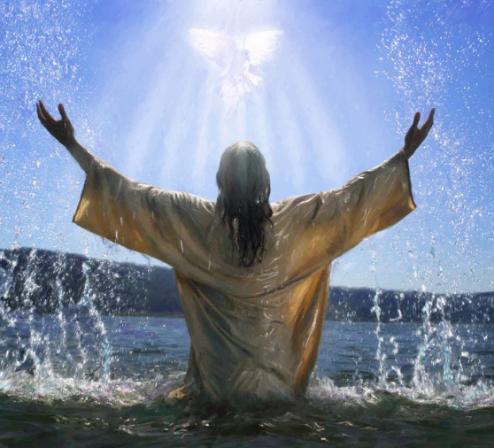
Jesus’ Heavenly Commendation "You are my beloved Son; with you I am well-pleased.“

Slide 16
The Baptism of Jesus
Luke 3:21-22
❶ Jesus’ baptism is one of the most significant moments in history.
❷ It is so significant that all four gospel writers recorded it!
❸ This is the moment in time when Jesus voluntarily enlisted!
❹ This is when Jesus put first your interests and chose you!
❺ This is when Jesus said YES!

Slide 17
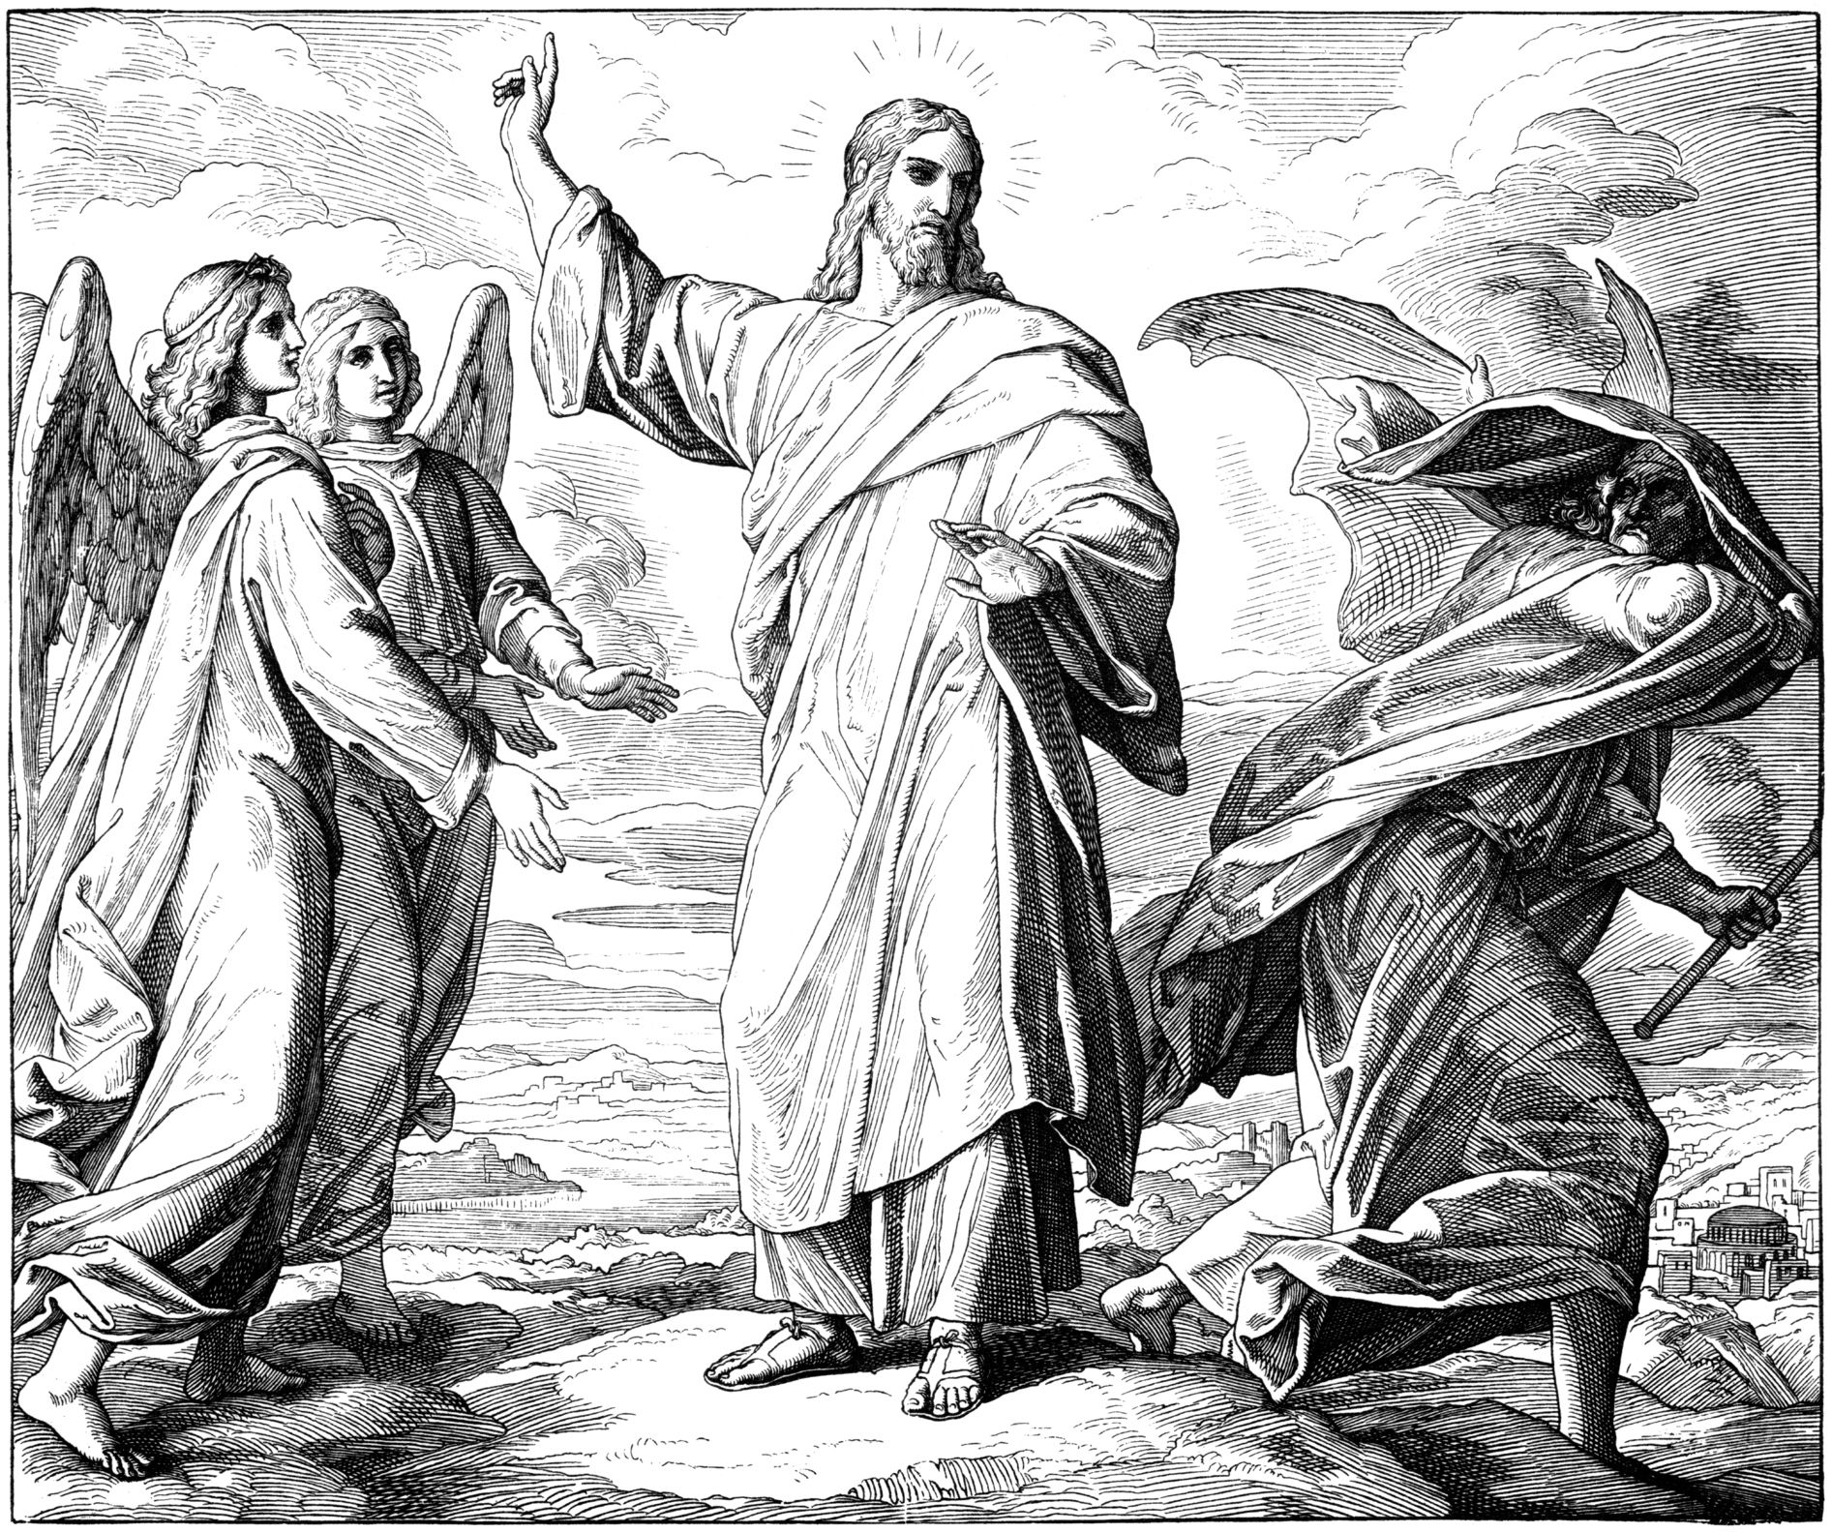
The Temptation of Jesus Luke 4:1-13

